Slide 1
Working with Rabbit MQ

Slide 2
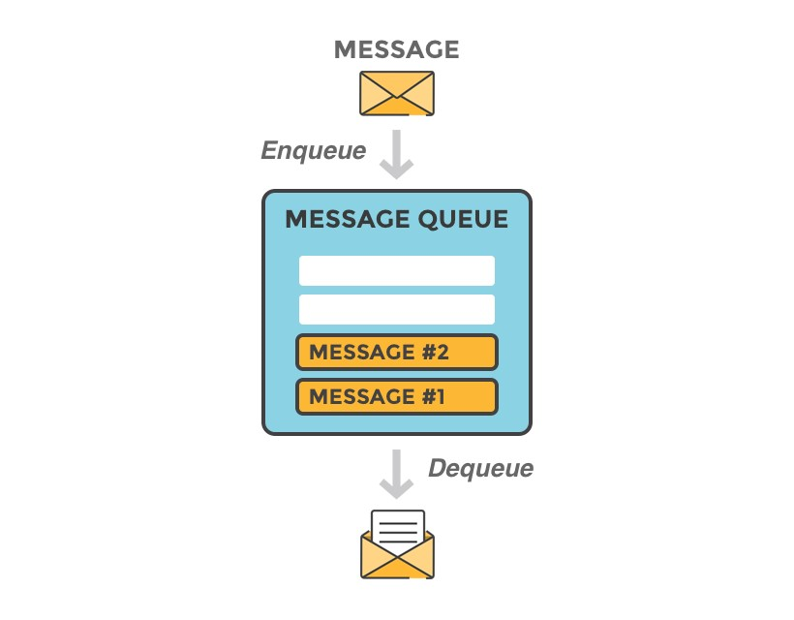
What is Rabbit MQ
Rabbit MQ is a message-queueing software also known as a message broker or queue manager. Simply said; it is software where queues are defined, to which applications connect in order to transfer a message or messages.

Slide 3
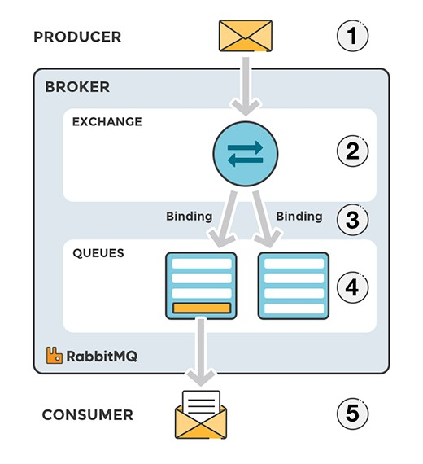
EXCHANGES
Messages are not published directly to a queue; instead, the producer sends messages to an exchange. An exchange is responsible for routing the messages to different queues with the help of bindings and routing keys. A binding is a link between a queue and an exchange.

Slide 4
Components of Rabbit MQ
Producer: Application that sends the messages.
Consumer: Application that receives the messages.
Queue: Buffer that stores messages.
Message: Information that is sent from the producer to a consumer through RabbitMQ.
Connection: A TCP connection between your application and the RabbitMQ broker.
Channel: A virtual connection inside a connection. When publishing or consuming messages from a queue - it's all done over a channel.
Exchange: Receives messages from producers and pushes them to queues depending on rules defined by the exchange type. To receive messages, a queue needs to be bound to at least one exchange.
Binding: A binding is a link between a queue and an exchange.
Routing key: A key that the exchange looks at to decide how to route the message to queues. Think of the routing key like an address for the message.
AMQP: Advanced Message Queuing Protocol is the protocol used by RabbitMQ for messaging.
Users: It is possible to connect to RabbitMQ with a given username and password. Every user can be assigned permissions such as rights to read, write and configure privileges within the instance. Users can also be assigned permissions for specific virtual hosts

Slide 5
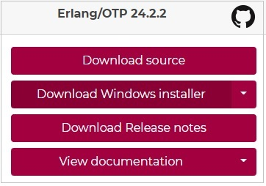
Download and Install Erlang
RabbitMQ is built on Erlang runtime so before installing RabbitMQ, we need to download Erlang and install it.
You can download the latest version of Erlang from its home page − erlang.org/downloads. We are installing Erlang on Windows and downloaded Erlang/OTP 24.2.2 Installer - otp_win64_24.2.2.exe for windows.

Slide 6
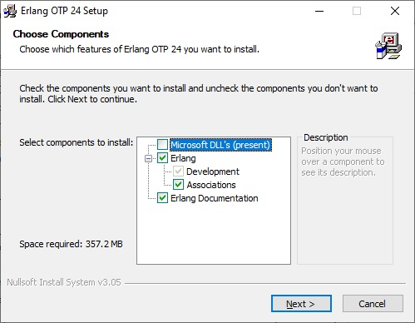
Download and Install Erlang
Now install the Erlang using the installer by double clicking on it and follow the default selections and finish the setup.

Slide 7
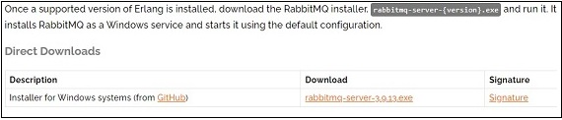
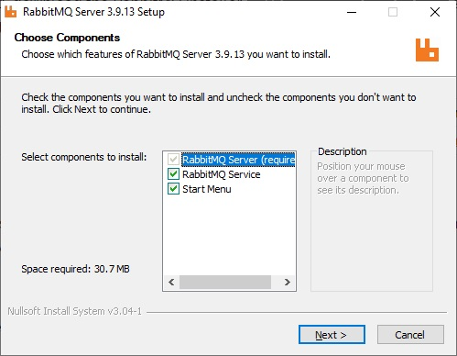
Download and Install Rabbit MQ
Download the RabbitMQ Latest binary from its official downloads page We've downloaded 3.9.13 as rabbitmq-server-3.9.13.exe for windows.
Now install the RabbitMQ using the installer by double clicking on it and follow the default selections and finish the setup.

Slide 8
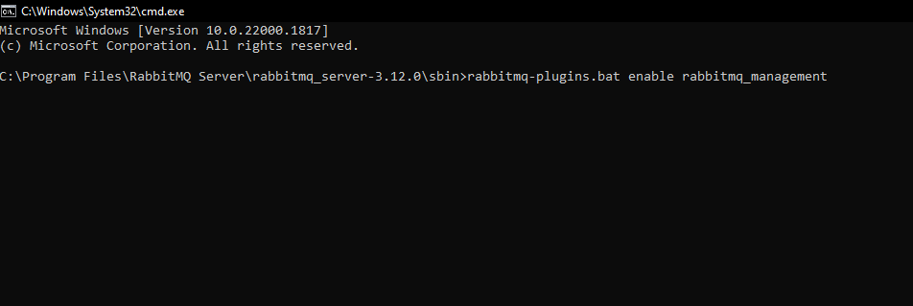
Download and Install Rabbit MQ
By default, RabbitMQ works as windows service. To enable Web based Administration UI, following step are needed.
Go to RabbitMQ Installation directory and type the commands as shown below

Slide 9
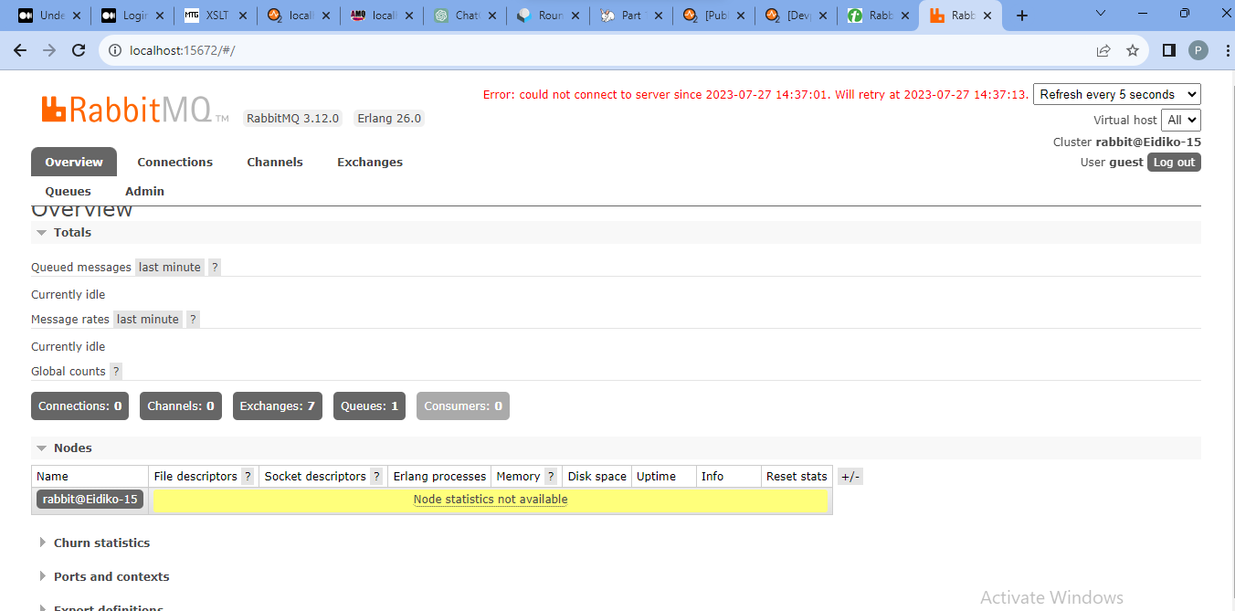
Download and Install Rabbit MQ
Now open http://localhost:15672/ to open Management console. Login using guest/guest.

Slide 10
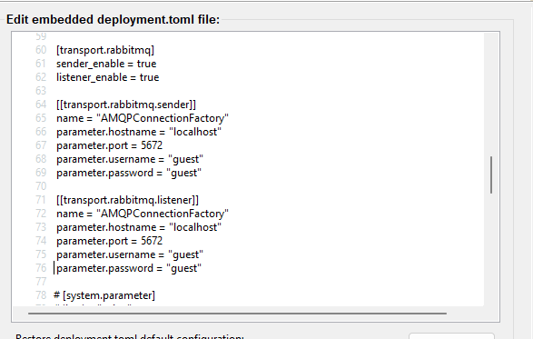
Rabbit MQ setup in WSO2 for Publish Message
Download the amqp-client-5.7.0.jar and add to <ESB_HOME>/lib file directory.
Select the Embedded Micro Integrator Server Configuration Wizard from the tool bar and add the following config to the Edit embedded deployment.toml file section to enable the ActiveMQ sender and listener transport.

Slide 11
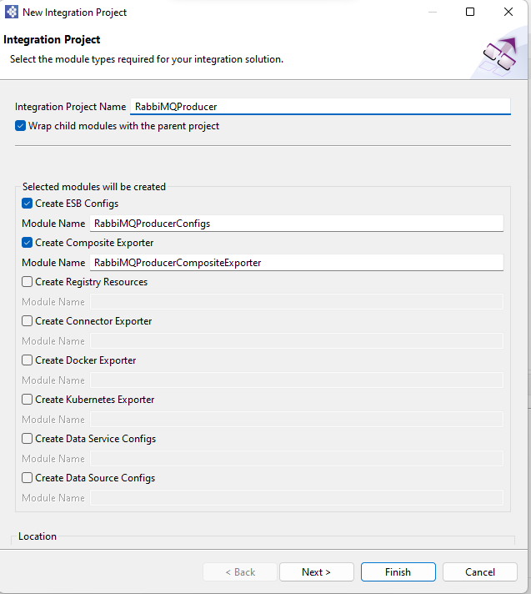
Rabbit MQ setup in WSO2 for Publish Message
Create Integration project and select ESB config, Composite Exporter and Connector Exporter.

Slide 12
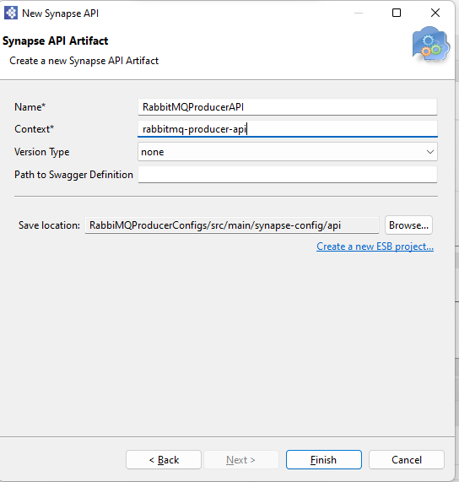
Rabbit MQ setup in WSO2 for Publish Message
Right click on API artefact in ESB Config and click new, select REST API.
Enter Name and context of API and click on next

Slide 13
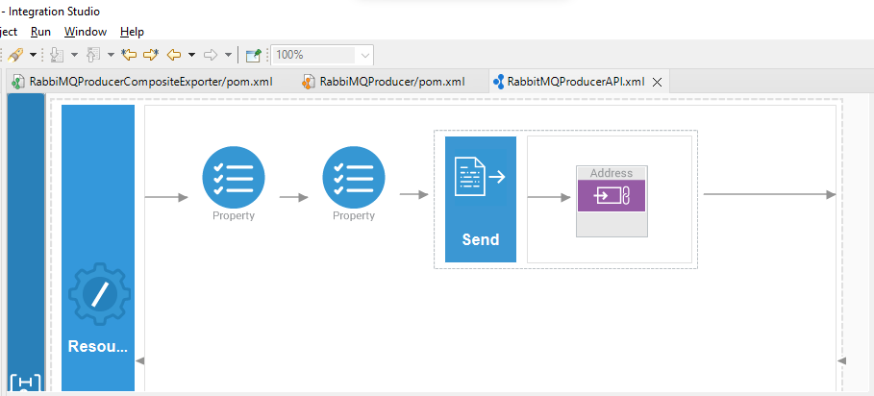
Rabbit MQ setup in WSO2 for Publish Message
From the Mediator palette, click and drag a Two Property and send Mediator to the In sequence.
From the Endpoints palette, click and drag Address Endpoint to the In sequence.

Slide 14
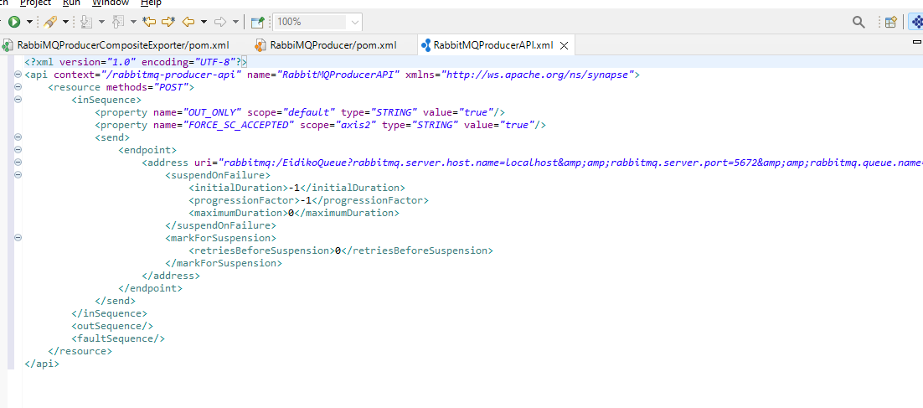
Rabbit MQ setup in WSO2 for Publish Message
Enter following details.
First property select name OUT_ONLY and give value true.
First property select name FORCE_SC_ACCEPTED and give value true.
Enter following uri of endpoint
rabbitmq:/EidikoQueue?rabbitmq.server.host.name=localhost&amp;rabbitmq.server.port=5672&amp;rabbitmq.queue.name=queue&amp;rabbitmq.queue.route.key=route&amp;rabbitmq.exchange.name=exchange

Slide 15
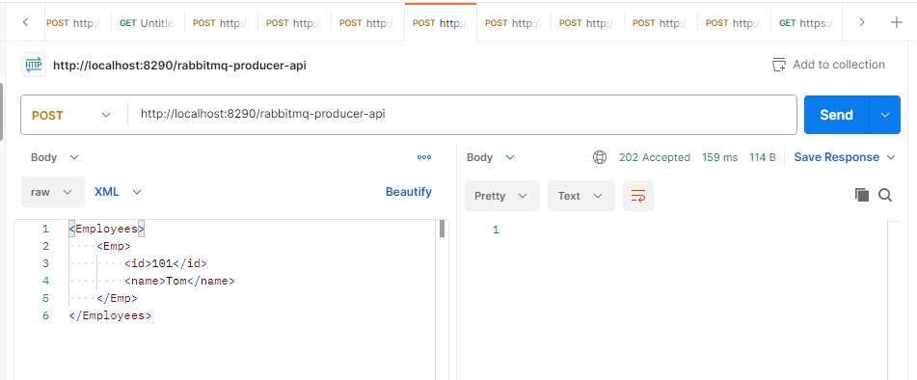
Test in Postman
Right click on the Project and configure the artifacts to the composite exporter and run it.
Through Postman send the request.

Slide 16
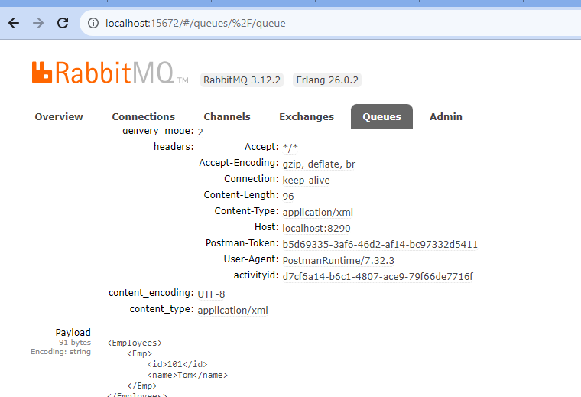
Test in Postman
Check message Rabbit MQ console

Slide 17
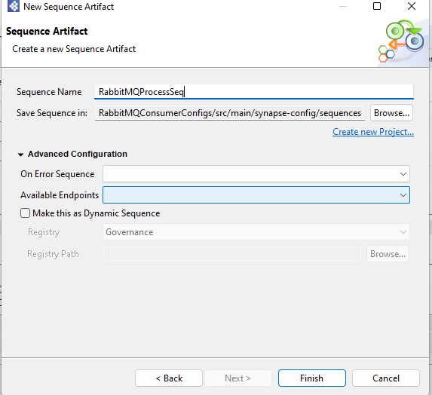
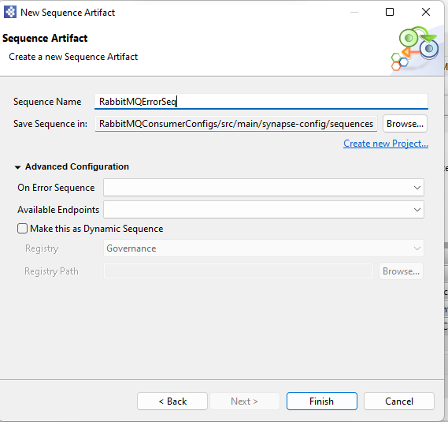
Rabbit MQ setup in WSO2 for Subscribe Message
Right click on Sequence artefact in ESB Config and click new, select Sequence .
Enter Name of Sequence and click on next.

Slide 18
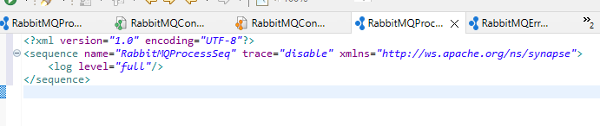
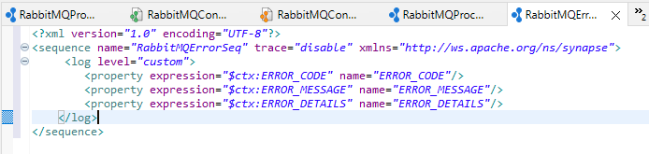
From the Mediator palette, click and drag log Mediator to the In both sequence.
In process sequence select log level full.
In error sequence add following properties.

Slide 19
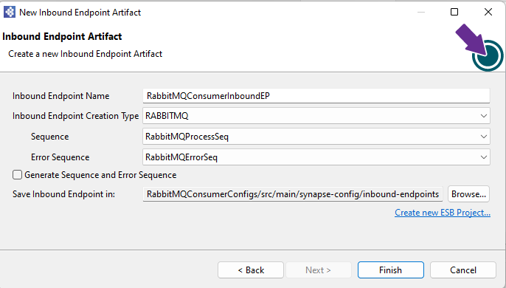
Rabbit MQ setup in WSO2 for Subscribe Message
Right click on Inbound Endpoint artefact in ESB Config and click new, select Inbound Endpoint.
Enter Name of Inbound Endpoint and click on next.
Select type, process and error sequence.

Slide 20
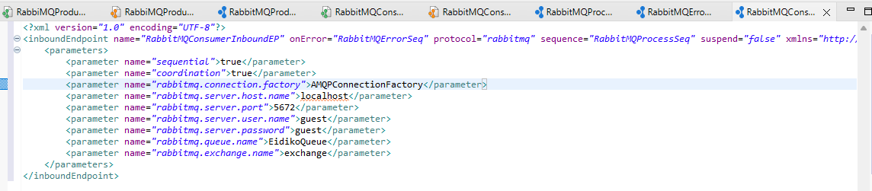
Rabbit MQ setup in WSO2 for Subscribe Message
Enter Following parameter and click on save.

Slide 21
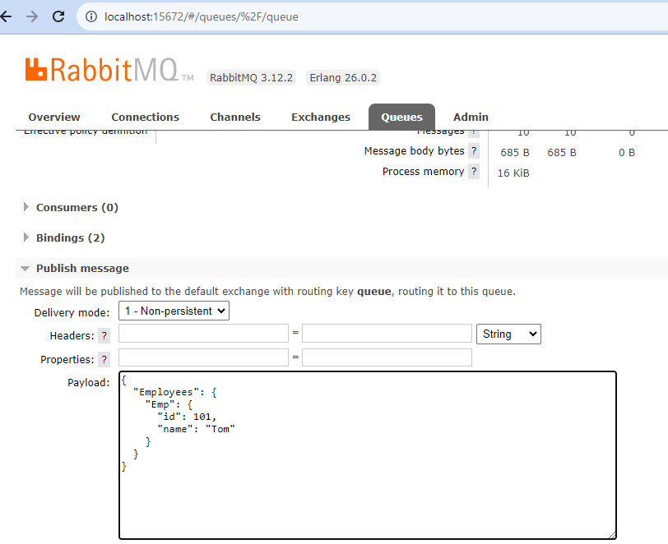
Test in Rabbit MQ Console
Right click on the Project and configure the artifacts to the composite exporter and run it.
Write the message in Rabbit MQ Queue and Click on publish.

Slide 22
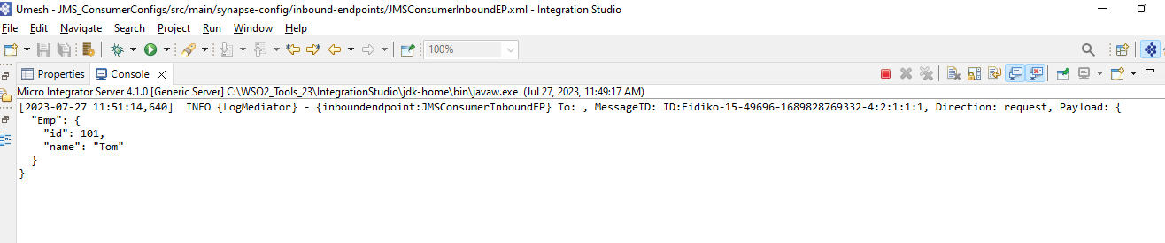
Test in Rabbit MQ Console
Check message in WSO2 Integration studio console

Slide 23


